Slide 1
Overview of the Data Visualization Course
Objectives:
Master data management and visualization in Excel.
Learn Python programming fundamentals for data analysis.
Explore data visualization libraries: Matplotlib, Seaborn, and Plotly.
Build interactive and advanced visualizations for real-world datasets.

Slide 2
The Key Principles of Data Visualization
Why does it matter?
Technical proficiency alone is not enough.
Effective storytelling is crucial.
Three Key Principles:
Strive for Clarity & Simplicity
Maximize impact, minimize noise.
Avoid unnecessary elements, focus on what matters.
Create a Narrative
Data visualization is about telling a story, not just showing data.
Communicate key insights clearly and powerfully.

Slide 3
The 10-Second Rule & Striking a Balance
Striking the Balance: Design vs. Function
Choosing the right chart type is critical.
Beautiful is good, functional is better—both is ideal.
The 10-Second Rule:
If a viewer can’t interpret the story within 10 seconds, simplify it.
Use formatting, intuitive color scales, and eliminate excess details to highlight the key insights.

Slide 4
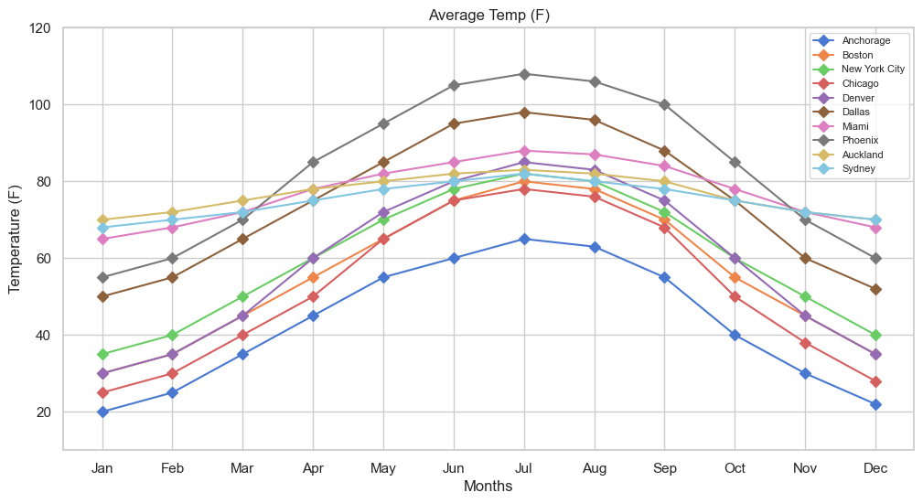
An Example of the 10-Second Eule
Compare the graph in this slide with the one in the next slide! They are generated using the same exact data.
Reference: Maven Analytics, Chris Dutton

Slide 5
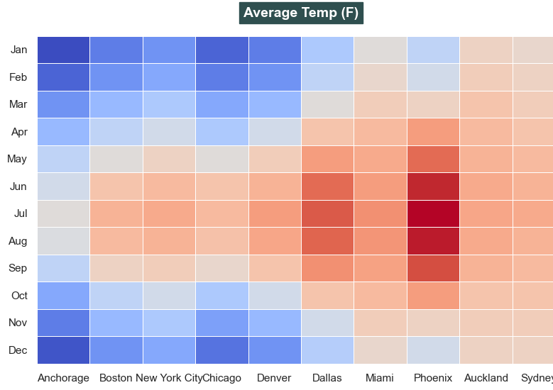
🎯 Remember: ✅ Clarity & Simplicity ✅ Narrative-Driven Approach ✅ Balance Between Design & Function
Reference: Maven Analytics, Chris Dutton

Slide 6
3 Key Questions for Effective Visualization
📌 1. What type of data are you working with?
Integer, real, categorical, time-series, geo-spatial, etc.
📌 2. What are you trying to communicate?
Relationship, comparison, composition, distribution, trending, etc.
📌 3. Who is the end user consuming this information?
Analyst, CEO, client, intern, etc.

Slide 7
Why Excel and Python Lead Data Visualization
1. Excel: The Accessible Powerhouse
User-Friendly Interface: Intuitive tools for creating charts, graphs, and pivot tables.
Wide Adoption: Used by professionals across industries, making it a universal tool.
Quick Insights: Ideal for small to medium datasets with instant visualization capabilities.
Integration: Seamlessly works with other Microsoft Office tools for reporting and presentations.
2. Python: The Programmer’s Choice
Flexibility: Libraries like Matplotlib, Seaborn, and Plotly offer endless customization.
Scalability: Handles large datasets and complex visualizations with ease.
Automation: Scripts enable repetitive tasks and dynamic, real-time visualizations.
Open-Source Ecosystem: Free to use with a vast community and continuous updates.
3. Together, They Dominate
Excel: Perfect for quick, business-ready visuals.
Python: Ideal for advanced, scalable, and automated visualizations.
Complementary: Excel for simplicity, Python for complexity—covering all data visualization needs.

Slide 8
Course Structure
1. Excel Basics
└─ Data Management & Formatting
└─ Basic Calculations
└─ Introduction to Charting
2. Python Fundamentals
└─ Python Basics (Data Types, Loops, Functions)
└─ Numpy & Pandas for Data Manipulation
3. Data Visualization with Python
└─ Matplotlib: Basic & Advanced Plotting
└─ Seaborn: Statistical & Categorical Plots
4. Advanced Visualization
└─ Pandas Built-in Visualization
└─ Plotly & Cufflinks for Interactive Visuals
└─ Geospatial Plotting with Plotly

Slide 9
Module 1: Excel for Data Management and Visualization
Data Management, Table Formatting, and Basic Excel Functions
Basic Excel Calculations (Percentages, Dates, AutoSum)
Introduction to Data Visualization and Excel Charting
Bar & Column Charts, Histograms & Pareto Charts, Line Charts, Pie & Donut Charts, Scatter & Bubble Charts, Bubble Charts, Box & Whisker Charts, Tree Maps & Sunburst Charts, Waterfall Charts, Funnel Charts, Radar Charts, Surface & Contour Charts, Stock Charts, Heat Maps Geospatial/Choropleth Maps

Slide 10
Module 2 - Python Fundamentals
Python Basics (Data Types, Loops, Conditionals)
Advanced Python Concepts (Functions, Lambda, List Comprehension)
Numpy Basics (Arrays, Indexing, Operations)
Pandas Basics (Series, DataFrames, Missing Data, GroupBy)

Slide 11
Module 3 - Data Visualization with Python
Introduction to Matplotlib (Basic Plotting)
Matplotlib Customization (Titles, Labels, Legends)
Advanced Matplotlib (Subplots, Layouts)
Introduction to Seaborn (Statistical Plots)
Distribution Plots (Histograms, KDE)
Categorical Plots (Box Plots, Violin Plots)
Matrix Plots (Heatmaps, Correlation Plots)
Regression Plots (Customizing Visual Styles)

Slide 12
Module 4 - Advanced Data Visualization
Pandas Built-in Visualization (DataFrame Plotting)
Plotly & Cufflinks (Interactive Visualizations)
Geospatial Plotting (Choropleth Maps)

Slide 13
Tools and Resources
Excel
Python (Jupyter Notebooks)
Libraries: Numpy, Pandas, Matplotlib, Seaborn, Plotly
Setup Instructions for Excel is provided by UCR in this link (Microsoft 365 Personal License for Students)
The setup instructions for Jupyter Notebooks can be found in the course materials, located in the "Setup Instructions" folder.

Slide 14
Optional Material
An optional lecture covering the basics of Tabular will also be provided at the end of this course.

